Slide 1
OOP
Java is an object-oriented programming (OOP) language
  Programming methodology that views a program as consisting of objects that interact with one another by means of actions (called methods)
  Objects of the same kind are said to have the same type or be in the same class

Slide 2
Java API
Classes
  Random, Scanner, Math
Objects
  Random rg = new Random();
  Scanner sc = new Scanner("System.in");
  Objects of a particular type are created by calling the constructor of the class using the new keyword.
  The name of the constructor is the same as the name of the class.
  What happens if you try Math m = new Math();?
Methods
  Scanner
    hasNext(), nextDouble()
  Random
    nextInt(4)
  Math
    max(), min()

Slide 3
Calling Methods
Instance Methods – belong to the object and are called using an object reference
  sc.hasNext();
    Returns true if this (sc) scanner has another token in its input.
  Scanner sc1 = new Scanner("System.in");
  Scanner sc2 = new Scanner(new File("data.txt"));
  String s1 = sc1.nextLine();
  String s2 = sc2.nextLine();

Slide 4
Calling Methods
Static Methods – belong to the class and are called using a class reference
  Math.max(4,6);
Give 2 examples of instance methods and 2 examples of static methods from the String class.
Give 2 examples of instance methods from the StringBuilder class, are there any static methods in this class?
What type of methods did we write last year?

Slide 5
Packages
A package in Java is used to group related classes, similar to a folder in a file directory.
Packages are used to avoid name conflicts, and to write better maintainable code.
Packages are divided into two categories:
  Built-in Packages (packages from the Java API)
  User-defined Packages (create your own packages)
What is output from the following statements?
    System.out.println(StringBuilder.class);
    System.out.println(String.class);
    System.out.println(Random.class);
  Why do we need an import statement for the Random class, import java.util.Random; and not for the String or StringBuilder classes?

Slide 6
Example
package tutorial.pkg1;
//notice package name
public class Tutorial1 {
public static void main(String[] args) {
String s1 = "Hello";
String s2 = s1.substring(2);
int x = 4;
}
}

Slide 7
Java Programs
A Java application program is a class with a method named main
  All Java application programs start with the main method
Java programs are divided into smaller parts called classes
  Each class definition is normally in a separate file whose name is the same as the class name followed by .java
Exercise
  Write a program that asks the user to enter the first name of a friend, a favourite activity, a favourite colour and an emotion, and then prints the following line (replacing the items in italics):
    I had a dream that name went activity and turned colour from emotion!

Slide 8
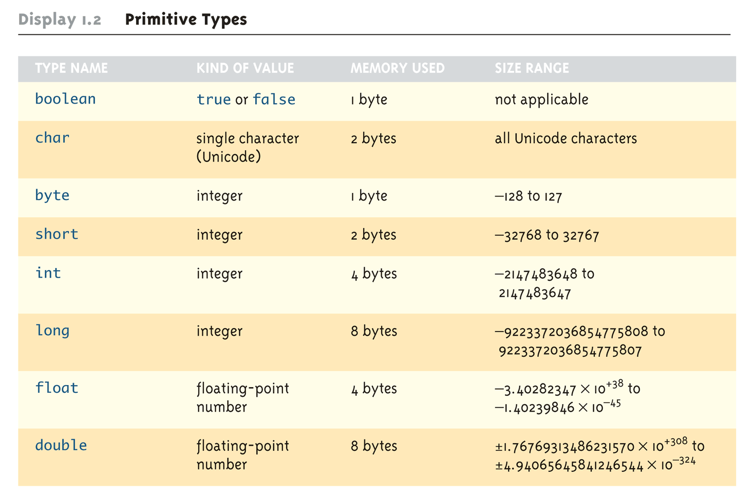
Primitive Types

Slide 9
Assignment Compatibility
A value of any type in the following list can be assigned to a variable of any type that appears to the right of it
  byte→short→int→long→float→double
An explicit type cast is required to assign a value of one type to a variable whose type appears to the left of it on the above list (e.g., double to int)
int i = 3;
double d = 4;
d= i;
i = (int)d;

Slide 10
Type Casting
A type cast takes a value of one type and produces a value of another type with an "equivalent" value
  If n and m are integers to be divided, and the fractional portion of the result must be preserved, at least one of the two must be type cast to a floating-point type before the division operation is performed
    double ans = n / (double)m;
  Note that the desired type is placed inside parentheses immediately in front of the variable to be cast
  Note also that the type and value of the variable to be cast does not change

Slide 11
Type Casting
When type casting from a floating-point to an integer type, the number is truncated, not rounded
  (int)2.9 evaluates to 2, not 3
When the value of an integer type is assigned to a variable of a floating-point type, Java performs an automatic type cast called a type coercion
    double d = 5;
In contrast, it is illegal to place a double value into an int variable without an explicit type cast
    int i = 5.5; // Illegal
    int i = (int)5.5 // Correct

Slide 12
The Class String
There is no primitive type for strings in Java
The class String is a predefined class in Java that is used to store and process strings
Objects of type String are made up of characters that are written within double quotes
  Any quoted string is a constant of type String
    "Live long and prosper."
A variable of type String can be given the value of a String object
  String blessing = "Live long and prosper.";

Slide 13
Classes, Objects, and Methods
A class is the name for a type whose values are objects
Objects are entities that store data and take actions
  Objects of the String class store data consisting of strings of characters
The actions that an object can take are called methods
  Methods can return a value of a single type and/or perform an action
  All objects within a class have the same methods, but each can have different data values

Slide 14
Example
public static void main(String[] args) {
String s = "Hello";
System.out.println("Enter something");
Scanner keyboard = new Scanner(System.in);
String s2 = keyboard.nextLine();
if (s==s2){
//sout tab
System.out.println("Same");
}
else{
System.out.println("different");
}
if (s.equalsIgnoreCase(s2)){
System.out.println("Same");
}
else{
System.out.println("different");
}
}
Sample Run
Enter something
Hello
different
Same

Slide 15
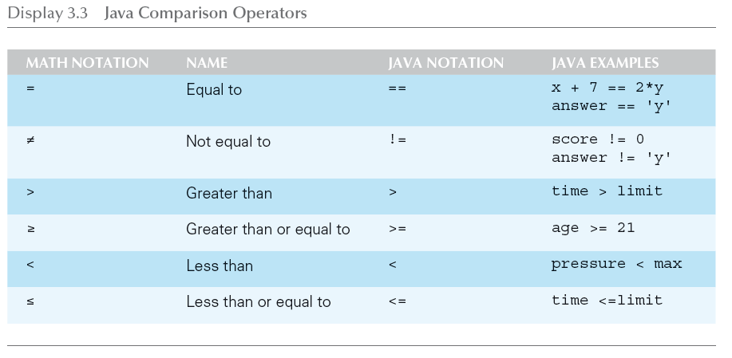
Java Comparison Operators

Slide 16
Pitfall: Using == with Strings
The equality comparison operator (==) can correctly test two values of a primitive type
However, when applied to two objects such as objects of the String class, == tests to see if they are stored in the same memory location, not whether or not they have the same value
In order to test two strings to see if they have equal values, use the method equals, or equalsIgnoreCase
    string1.equals(string2)
    string1.equalsIgnoreCase(string2)

Slide 17
Invoking or calling a method
A method is called into action by writing the name of the calling object, followed by a dot, followed by the method name, followed by parentheses
    Scanner input = new Scanner(System.in);
    String s2 = input.nextLine();
  This is sometimes referred to as sending a message to the object
  The parentheses contain the information (if any) needed by the method – arguments

Slide 18
Invoking or calling a method:
A method is called into action by writing the name of the class containing the method, followed by a dot, followed by the method name, followed by parentheses....
Scanner input = new Scanner(System.in);
int num1, num2;
int max;
num1 = input.nextInt();
num2 = input.nextInt();
max = Math.max(num1, num2);
System.out.println(max);

Slide 19
Invoking or calling a method
A method is called into action by writing the method name, followed by parentheses....
public static void main(String[] args){
  String code = " ";
  String newCode = " ";
  code = getValidId1("Enter Code");
  // code = Sample.getValidId1("Enter Code");
  newCode = changeId(code); System.out.println(newCode);
  }

Slide 20
Invoking or calling a method:
public static String changeId(String id){
int pos;
String start;
String ends;
String newString;
pos = id.indexOf("R");
start = id.substring(0, pos);
ends = id.substring(pos+1);
newString = start + "rr" + ends + getRandomCharacter(id);
return newString;
}
This method exists in the Sample class.

Slide 21
String Methods
The String class contains many useful methods for string-processing applications
  Some String methods are called by writing a String object, a dot, the name of the method, and a pair of parentheses to enclose any arguments
  Some String methods are called by String class, a dot, the name of the method, and a pair of parentheses to enclose any arguments
  System.out.println(String.valueOf('x'));
  If a String method returns a value, then it can be placed anywhere that a value of its type can be used
    String greeting = "Hello";
    int count = greeting.length();
    System.out.println("Length is " + greeting.length());

Slide 22
Console Input Using the Scanner Class
Java includes a class for doing simple keyboard input named the Scanner class
In order to use the Scanner class, a program must include the following line near the start of the file:
  import java.util.Scanner
This statement tells Java to
  Make the Scanner class available to the program
  Find the Scanner class in a library of classes (i.e., Java package) named java.util

Slide 23
Console Input Using the Scanner Class
The following line creates an object of the class Scanner and names the object input :
  Scanner input = new Scanner(System.in);
Once a Scanner object has been created, a program can then use that object to perform keyboard input using methods of the Scanner class

Slide 24
Console Input Using the Scanner Class
The method nextInt reads one int value typed in at the keyboard and assigns it to a variable:
  int numberOfPods = input.nextInt();
The method nextDouble reads one double value typed in at the keyboard and assigns it to a variable:
  double d1 = input.nextDouble();
Multiple inputs must be separated by whitespace and read by multiple invocations of the appropriate method
  Whitespace is any string of characters, such as blank spaces, tabs, and line breaks that print out as white space

Slide 25
Console Input Using the Scanner Class
The method next reads one string of non-whitespace characters delimited by whitespace characters such as blanks or the beginning or end of a line
Given the code
  String word1 = input.next();
  String word2 = input.next();
and the input line
  jelly beans
The value of word1 would be jelly, and the value of word2 would be beans

Slide 26
Console Input Using the Scanner Class
The method nextLine reads an entire line of keyboard input
The code,
  String line = input.nextLine();
reads in an entire line and places the string that is read into the variable line

Slide 27
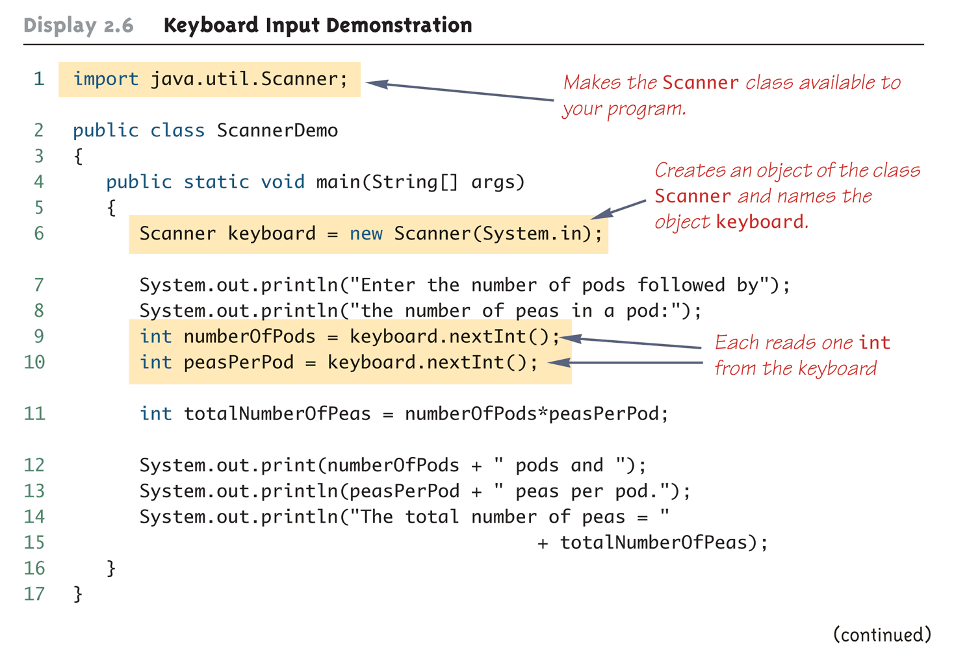
Keyboard Input Demonstration
(Part 1 of 2)

Slide 28
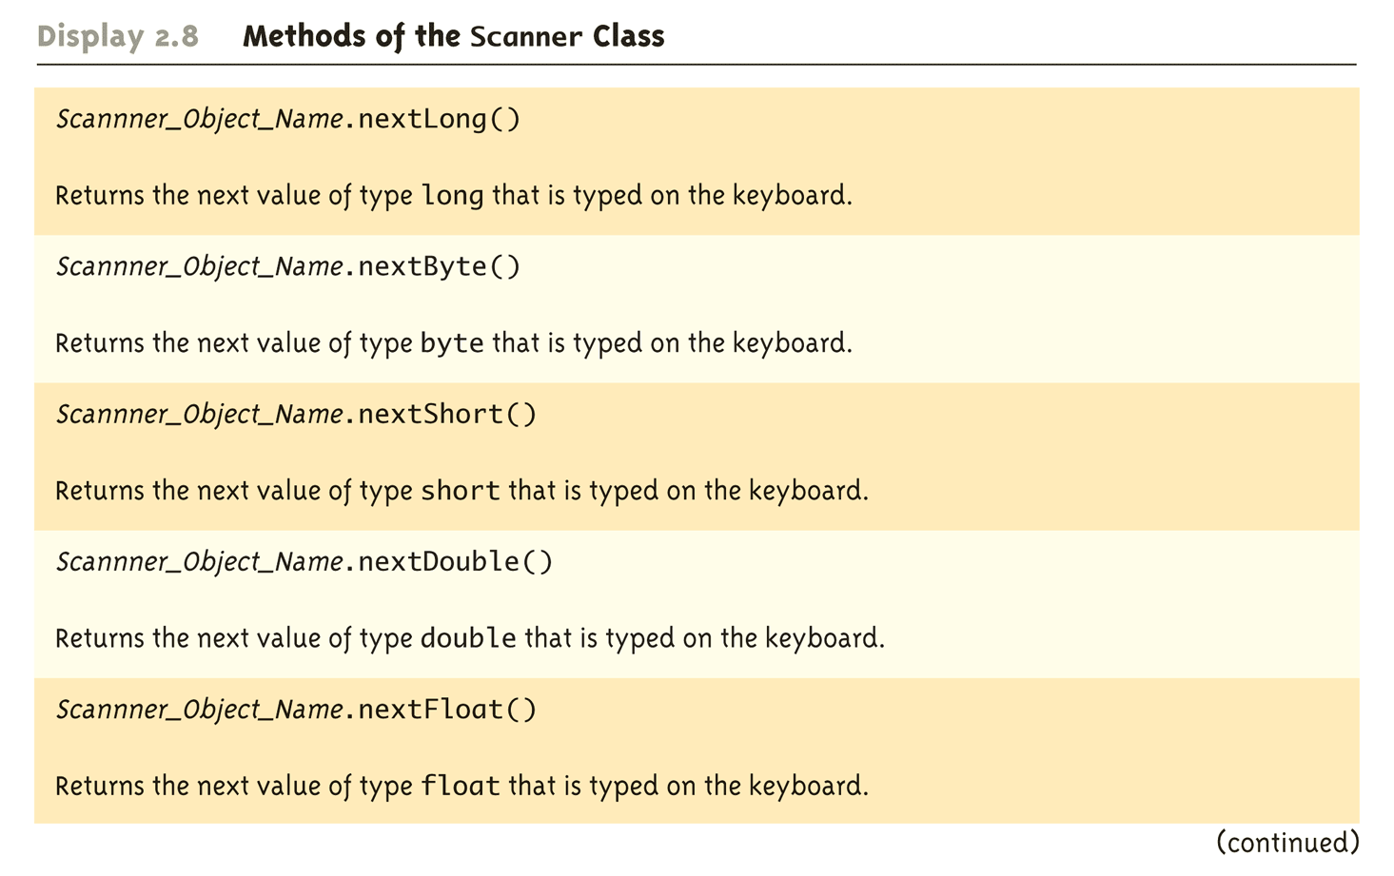
Methods in the Class Scanner
(Part 2 of 3)

Slide 29
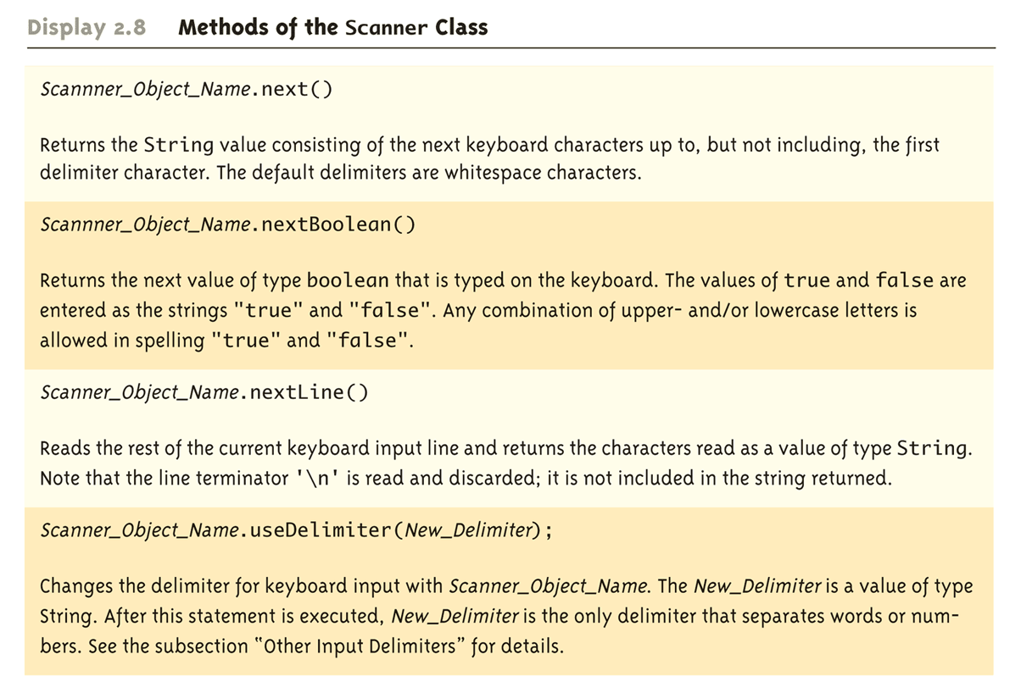
Methods in the Class Scanner
(Part 3 of 3)

Slide 30
Other Input Delimiters
The delimiters that separate keyboard input can be changed when using the Scanner class
For example, the following code could be used to create a Scanner object and change the delimiter from whitespace to "##"
  Scanner input = new Scanner(System.in);
  input.useDelimiter("##");
After invocation of the useDelimiter method, "##" and not whitespace will be the only input delimiter for the input object input

Slide 31
Exercise
Write a program to:
Create two Scanner objects, sc1, sc2
Change the delimiter for the second object, sc2 to ##
Use the next() method to input two words
Input the following string, one two##three using sc1 first and then sc2
Output the words

